Slide 1
Meeting the Needs of our Learners:
Redesigned Curriculum
Prince Rupert
Notes:
Who is in the room – How many have seen Jan and Maureen present
Classroom teachers?, non enrolling, administration?
In primary group – who has been working side by side with Fiona? Who has participated with Fiona in one of her presentations?
Suzanne to start – lay ground work of why the change

Slide 2
Why Redesign our Curriculum:
Present construct of the curriculum is 20+ years old
Learners today are not the learners of 20 years ago and the world has changed
We know lots more about teaching and learning
Feedback from teachers and educators:
more flexibility
explore passions and interests of kids
allow for a better fit for different communities
Notes:
Present curriculum was designed in 1994:
- think of the changes we have seen in our society in 20 years
- think about how our kids are different
- look at the body of research – we may have had hunches, now we have studies and evidence
- teachers said for many years in this province that they had too many prescribed outcomes to cover – somewhere in grade 5 of over 350 learning outcomes
Curriculum based on outcome vs concepts – what is different – how is it constructed, how does it make our practice different?
Global movement – many commonalities as to how different jurisdictions are approaching

Slide 3
Core Competencies - in your work with students ……
Notice them, name them and nurture them
Use the language with kids
Together, focus on learning about them
Build student ownership and voice
Notes:
Core Competencies are foundational in this curriculum – give us our overall purpose of schooling, align with the Educated Citizen and are agreed upon skills that the world of work, business etc. suggests are needed for success
(thinking like a scientist, historian, communicating like an author a mathematician)
what makes a good thinker, the difference between critical and creative thinking, aspects of good communication, what it means to have a positive personal identity
Can they describe their personal development of the core competencies?
Core competencies are embedded in the curricular competencies, however, we do also need to pay attention to them and ensure that they come alive in our classrooms
Start by noticing them, naming them and nurturing them
They is a uniqueness about their expression in different disciplines – use the language, talk about how historians think, authors communicate
Make them explicit with kids, talk about the aspects, go into the profiles
Incorporate the core competencies in your self-assessment work with kids

Slide 4
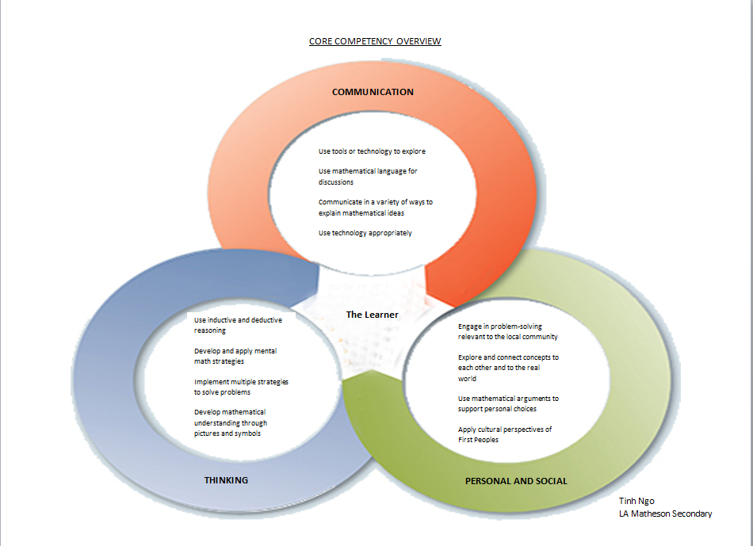
Notes:
Core competencies are clearly aligned and expressed in the curricular competencies
Here is an example of how a teacher of Grade 8 and 9 math, took the curricular competencies and identified which core competencies they connected to – this helped him make sense of how the core are embedded and how paying attention to the curricular competencies would in fact activate the core competencies
Sharing this with kids helped them see what they were learning, how it links to the core competencies and why it is important

Slide 5
This curriculum lends itself to instructional design that focuses on:
Inquiry based
Different groupings and varied classroom structures
Less teacher directed lessons and more student hands on/minds on exploration
Backward design
Project Based and Problem Based approaches
Design thinking
Notes:
-this curriculum leans towards instructional design that is more learner centred and less teacher directed
-opportunities to explore passions and interests and fit the curriculum with your community
-better meet the needs of our learners
-teachers asked for curriculum that allowed them to do the things they were doing – more of!
-more open ended, allowing teachers to shape it more to their kids
There is still a need within these instructional approaches for knowledge – but with an emphasis on applying it
Teachers will still give “lessons”, directly teach, but in the context of the bigger picture – who needs additional instruction, may be more in small groups or with specific kids
Build knowledge, skills and understanding in tandem

Slide 6
Planning
Teachers will approach planning differently
Teachers might:
begin with the Big Ideas
start with important content
consider the curricular competencies
Notes:
-There isn’t just one way to approach the curriculum and teachers will begin in different ways
Allows you to approach it according to where you are and feel most comfortable
One way to begin is to start with a topic or unit that you love to teach
Start by just tweeking the unit, incorporating more choice, projects, an inquiry question

Slide 7
What is Inquiry?
Inquiry is a dynamic process of being open to wonder and puzzlement and coming to know and understand the world
Inquiry is based on the belief that understanding is constructed through the process of people working and collaborating together as they pose and solve the problems, make discoveries and rigorously test the discoveries
Inquiry is essential to the way in which knowledge is personally and collectively constructed and created
Notes:
Inquiry is a structure that aligns with this curriculum
Consider how new discoveries and inquiries have impacted our world form electricity to new technologies – everything new invention, or discovery from technology to medicine comes about because some one had a question or a problem that needed to be addressed in some way
How we introduce Inquiry needs to be in a way that we as teachers are comfortable with so: If this is new for you, find a way to enter into the process comfortably

Slide 8
Essential Questions in an Inquiry Approach
derived from the big ideas and are the basis of deep learning
linked to the students, their community, interests and passions
based on important concepts – “Sticky Questions”
guide and focus the inquiry
shape the learning experience to the context and interdisciplinary studies
best generated and shaped with students
Notes:
Questions are key to Inquiry
What makes for a good inquiry question – must be deep, open ended, meaningful
-can be developed by teachers or better when developed or refined together with students
Key to any inquiry is the quality of the question – can’t be “googleable”, has to be deep, allow kids to go in different directions, best when linked to the kids community – eg. The grade 6 girls in North Van who were hearing about how people would go out on the trails, not knowing the area, and not allowing for enough light – so they created an app!

Slide 9
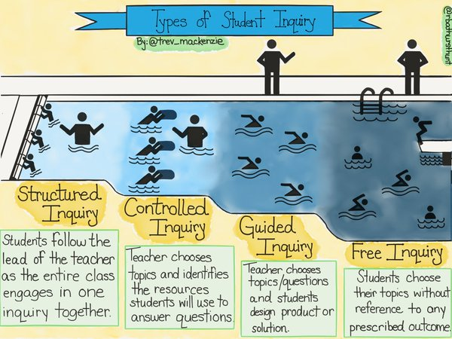
Notes:
-Here is a teacher Trevor Mackenzie who has looked at inquiry
-this may be helpful as you prepare your kids to work in this kind of way in your classroom. Approaching inquiry in this way may allow for some scaffolding as we get more comfortable with this kind of approach
-Introducing the structure as we get comfortable, working together with our kids so that they understand the expectations
Describe the Pool as an analogy for them as well as kids
Jump into the pool – gently, practicing your skills, with a mentor and a buddy, taking the next steps, progressing to where you “can’t touch” to swimming freely in the arena of inquiry

Slide 10
Check out this resource
Focus on Inquiry
Authors: Sharon Friesen with Candace Saar, Amy Park, Chenoa Marcotte, Tony Hampshire, Barb Martin, Barb Brown & Judy Martin
Galileo Educational Network | Werklund School of Education, University of Calgary
© 2015 Galileo Educational Network
Notes:
-This is an excellent resource – Canadian educators
Downloadable resource
-6 chapters on inquiry

Slide 11
An Interdisciplinary Approach
English Language Arts: Learning Standards
Curricular Competencies
Recognize how literacy elements, techniques and devices enhance meaning in text
Use creating and design processes to develop and create texts for a variety of purposes and audience
Use inquiry in creative and playful ways to develop style
Content
Literacy elements and devices
The Arts: Learning Standards
Curricular Competencies
Intentionally select artistic elements, processes, materials, movements, technologies, tools and techniques and environment to express meaning in a creative way
Create artistic works collaborative and as an individual using ideas inspired by imagination, inquiry, experimentation, and purposeful play
Express feelings ideas and express through the arts
Content
Elements of design
Notes:
-Here is an example of an inter-disciplinary unit – ELA and The arts
-Grade 4/5 class in surrey
Teacher took two areas that she was comfortable with – ELA and Fine Arts
You can see the clear connection to the core competencies in the work of the kids – Communication and Personal Identity

Slide 12
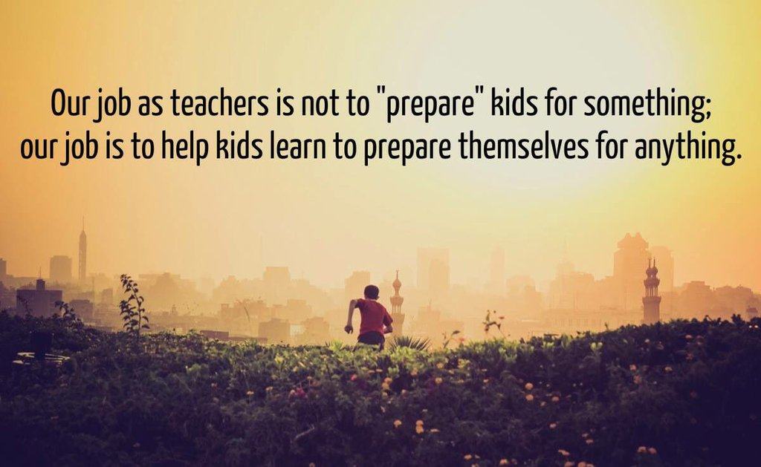

Slide 13
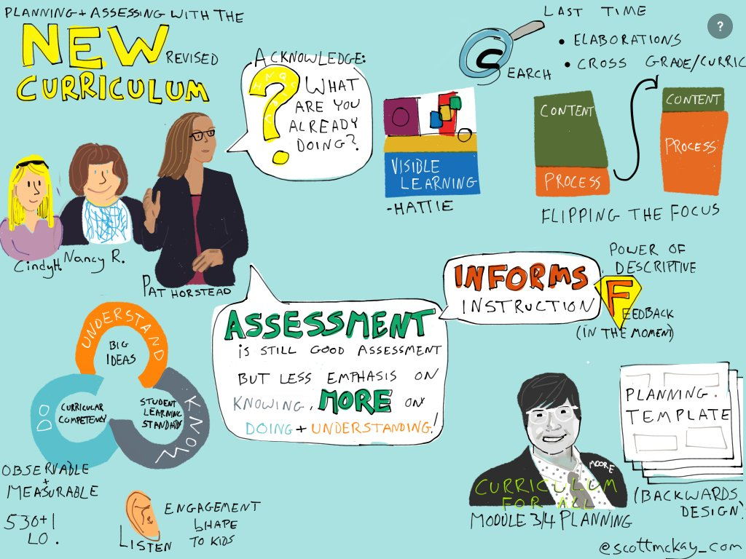
CLASSROOM ASSESSMENT
C

Slide 14
Assessment – Focus for Today
Principles of Assessment
Success Criteria
Descriptive Feedback
Questioning
Self-assessment

Slide 15
How we conceptualize curriculum and instruction, impacts and influences the way that we assess, evaluate and ultimately report.
As our classrooms change and we teach differently, we need to assess differently.

Slide 16
Meta Analysis – Supporting Learners
John Hattie’s work suggests importance of students being active in the learning process, feedback (informative rather than evaluative), challenging but achievable goals, questioning (open ended, clarifying, extending)
Black and Wiliam’s work suggests the importance of assessment for learning – clear goals, descriptive feedback, questioning, student self-assessment
Robert Marzano work suggested that effective assessment improved learning
Notes:
Biggest gains have been shown to be for the most at risk students

Slide 17
5 Principles of Assessment (Black and Wiliam)
Clear goals and expectations should be established and clearly understood by students (success criteria shared)
Students have the opportunity to demonstrate their learning through an active learning process
Descriptive feedback provides the learner with important information to move their learning forward
Questions are open ended and uncover misconceptions, clarify, and extend thinking
Self-assessment and peer assessment are important in developing our student’s ability to assess themselves
Notes:
-Research from black and wiliam over the last 20 years, started with Out of the black box
-impact on assessment worldwide
-research into effective assessment practices and student learning
-formed assessment groups in UK, Canada, Us
The ultimate goal is for students to be able to assess themselves and set their own learning goals!

Slide 18
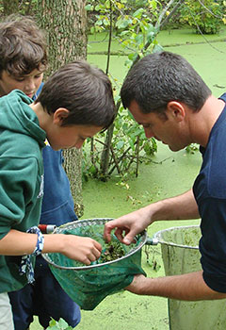
What do we need to think about when we are assessing?
The child
Stages of development
The discipline & pedagogy
The next steps
Notes:
The individual learner – what do we know about this learner?
The expected stages of development - what does it look like when students become more proficient and competent (the levels of performance)?
What is key in the discipline, what are my learning goals, what instructional strategies fit and what descriptive feedback or questions could I use?
What is the “just right” thing to do to support the learner or learners moving forward

Slide 19
Assessment Principles
fair, transparent, meaningful and responsive to all learners
focuses on the curriculum model – knowing, doing, understanding
provides ongoing descriptive feedback to students
is ongoing, timely, specific, and embedded in day to day instruction
provides varied and multiple opportunities for learners to demonstrate their learning
Notes:
These principles were developed by the working group – made up of BCTF teachers named to the group as well as members named by the BCPVPA. They will form the basis of the support document under development

Slide 20
Assessment Principles
involves students in their learning
promotes development of student self-assessment, goal setting and identifies next steps in learning
allows for a collection of student work to be gathered over time to provide a full profile of the learner and learning
communicates clearly to the learner and parents where the student is, what they are working towards and the ways that learning can be supported

Slide 21
So what is Different?
focus on doing, building understanding not just knowing
including students in the process
more embedded, ongoing assessment linked to instruction
less of an “event” at the end
purpose is to identify gaps and areas to extend learning
provides information that helps teachers adjust instruction – is my instruction working?
Notes:
What can you do with the knowledge and information – Can you apply it
Importance of including the learner
Tests, exams and basing student evaluation on the one thing rather than all the things that you know about the learner

Slide 22
emphasis on descriptive feedback and feedback to the student in the moment
Focus on questioning as a way to clarify and extend thinking and uncover “misconceptions’
assessment to determine who needs more guidance, a mini lesson, small group instruction, different approach, targeted approach
builds a profile of a student from evidenced gathered over time rather than a set of marks
recognizes the continuum between formative and summative
Notes:
How does it look different

Slide 23
Pick a Principle
Choose one of the principles. What are the practices that align? What does it look like in your classroom? What could you do more of? Less of?
Where are you in your understanding and application of the principles?

Slide 24
There is a Shift in Assessment
What are some of the “shifts” for you when you think about assessment?
What are some of the things you have started to do differently in your work with students?
What are some of the questions that still come to mind?
Notes:
Provides for a variety of different ways for kids to demonstrate their learning
Focuses on building in more assessment for learning specifically descriptive feedback and questioning
Incorporates more self-assessment, help kids develop metacognitive skills and self reflective
Assess on an ongoing basis ( less at the end)
Explore ways to capture and document evidence of learning

Slide 25
Establishing Success Criteria
When we invest time up front to build the vision [of what students are to be learning, we gain it back later in increased student motivation and the resulting higher‐quality work.
(J. Chappuis)

Slide 26
Developing Success Criteria
Let’s go back to the inter-disciplinary unit based on ELA and the Arts
Look at the learning standards
What would the criteria for success be?
What would you hope to see in kids work?
Look at the kids examples:
What are the qualities and attributes you see in the student work?
What are the qualities and attributes that you see in the one that you think is most closely aligned to excellence? What sets it apart?

Slide 27
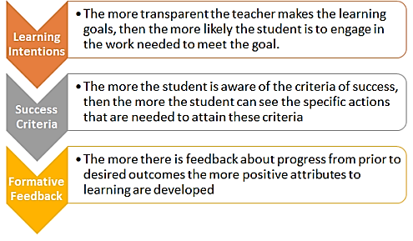

Slide 28
We ensure students understand success by:
Identifying and co-constructing criteria for success
Sharing and clarifying success
Using student friendly language
Using samples, models, exemplars to show success
Modeling process of applying success criteria to examples, samples
Having students practice applying success criteria to anonymous examples
Using the success criteria for teacher feedback, self assessment and peer assessment

Slide 29
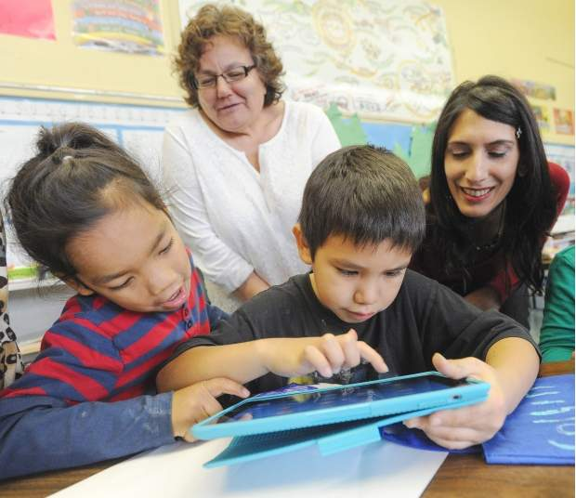
Assessment Supporting Learning….
“To be effective, feedback needs to cause thinking. Grades don’t do that. Scores don’t do that. And comments like “Good Job” don’t do that either.” Dylan William
…assessment and reporting
Notes:
effective feedback, if it is to serve learning and improvement
Quote the study in UK – Wiliam looked at a district that had been incorporating AFL for 10 years. Didn’t see the rise in student learning. Conclusion was that the two elements that are most difficult – descriptive feedback and questioning were not implemented in a deep way.

Slide 30
Descriptive Feedback (Hattie, Timperley)
Where am I going? ( Feed Up)
Focuses feedback on goals or targets
How am doing? ( Feed back)
Feedback references criteria and what success would look like and where a student is in the process
Where to next? (Feed forward)
Feedback helps student gain more clarity about what they know and can do to in order to apply and use the feedback now and in the future

Slide 31
Descriptive Feedback (Shirley Clark)
Closing the Gap
Where the learner is and where they need to go
Success
Where the work aligns with target or success criteria
Improvement
Where a student could improve
Suggestion
A specific focused suggestion (can you say more about..)

Slide 32
Meaningful Feedback
Elevate
Suggest
Inquire
Reflect
RISE MODEL

Slide 33
Descriptive Feedback ( Emily Wray)
Reflect
Recall and communicate specific aspects of learning towards the target I like how you ….
Inquire
Seek information and clarification What might it look like if ….
Suggest
Offer idea for improvement You might want to include….
Elevate
Expand the feedback beyond the original scope You might consider …

Slide 34
Creating Feedback Prompts
Consider one of the organizers – or combine some of the organizers
Create a list of prompts that you could use to provide students descriptive feedback

Slide 35
Questioning
Specifically, strategic questioning provides teachers with the opportunity to identify and correct misunderstandings and gaps in knowledge, as well as identify the need for extension work for those students whose knowledge and skills base demand it.
This kind of questioning provides information about student knowledge, understanding and skills that informs the teacher's planning and selection of teaching strategies to move students from where they are to where they need to go.
Dylan Wiliam

Slide 36
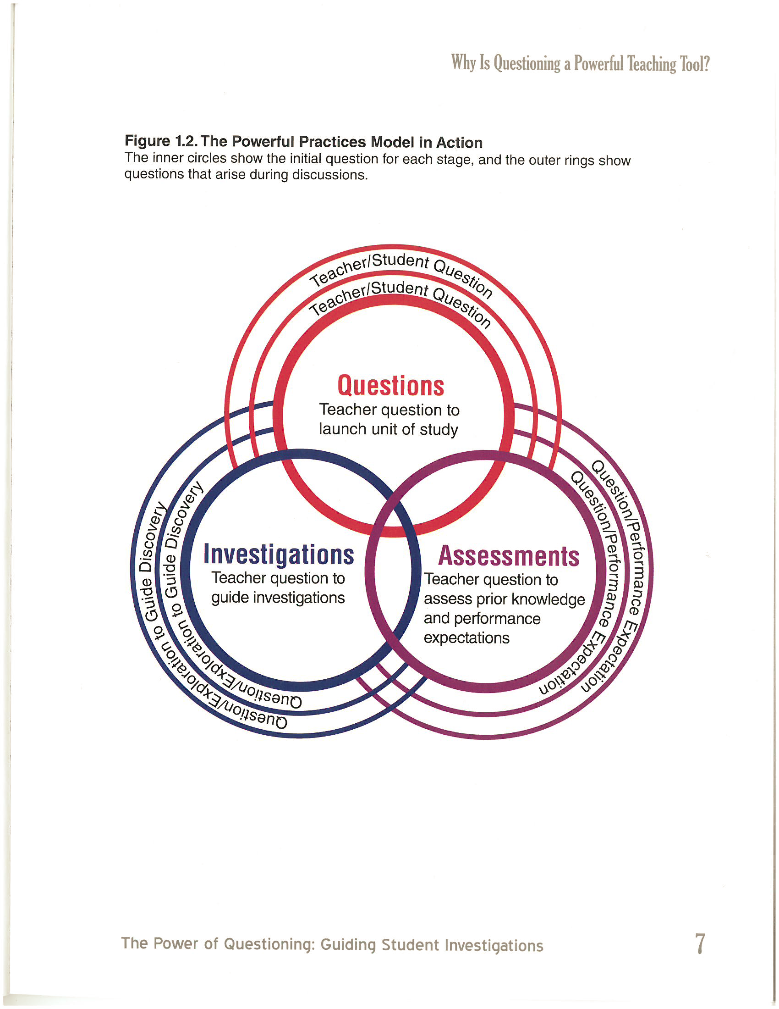
Power of Questioning: Guiding Student Investigations
J. McGough & L. Nyberg
Teachers ask questions to identify students level of understanding and any misconceptions that may need additional teacher interventions
Notes:
We asked questions for many purposes
- To establish inquiries
- To guide investigations
- To assess
What is prior knowledge, what do they know, not know, level of understandings as they student is moving through the learning experience, what do I need to do to support the student – what are the gaps, what information or knowledge are they missing, how are they reflecting on their learning

Slide 37
Questioning
Questioning is one of the most difficult skills to develop as a teacher :
Are my questions open ended?
Are my questions inviting?
Did my question extend thinking – student continues to elaborate and clarify?
Do I ask students to build on other’s thinking?
Did I remember to give enough wait time?
What effect is my questioning having on my students?
Notes:
Audio tape yourself – what do you notice?

Slide 38
Self-Assessment and Reflections
Remembering – What did I do?
Understanding – What was important about it?
Applying – Where could I use this again?
Analyzing – Do I see any patterns?
Evaluating – How well did I do?
Creating – What should I do next
Peter Pappas – Taxonomy of Reflection
Notes:
Peter Pappas – suggests that the kind of questions and ways we build self assessment skills of students can be described in a taxonomy – based on Bloom’s
Lower level of remembering and asking students to recall, to creating
Way of ensuring that self-assessment is deepening and developing students meta-cognitive skills

Slide 39
Prompts for conferencing
Remembering
Can you show an example?
Understanding
What is the point of knowing how to do this?
Applying
Where could you use this (content, product, or process) in your life?

Slide 40
Analyzing
What were the results of the approach you used, was it efficient and effective? What adjustments could you make?
Evaluating
What have you learned about your strengths and areas for improvement?
How are you progressing as a learner?
Creating
How can you use your strengths to improve?
Where can you take this learning next?

Slide 41
Assessment – How Might I Start?
allow different ways for students to represent learning
consider multiple ways of gathering evidence
emphasis on observations, descriptive feedback, questioning, conferencing and interviewing
build language of thinking, communicating, personal & social competence in relation to the disciplines
develop ownership and student voice through self-assessment of the Core Competencies
Notes:
Key principles to start with – give kids different ways to show what they know and can do
Gather broad range of different types of information using a variety of tools
Incorporate self assessment and help kids develop the metacognitive and self awareness skills
Ultimately, they have to assess themselves
- Really important to see assessment as ongoing and a part of instruction – linked
Descriptive feedback, questions for “uncovering” misconceptions, clarifying and extending thinking
Interplay of content – for application
Thinking like a scientist, communicating like a mathematician
Not one size fits all
Deepen our assessment practices

Slide 42
With a partner/group talk about Assessment
What are the things that you will take away as “ahaa’s” ?
What do you want to learn more about?
What are you already doing – what will you do more of?
What will you do less of?
What is your burning question?

Slide 43
COMMUNICATING STUDENT LEARNING AND
REPORTING

Slide 44
In your experience . . . .
What are the important things that parents want to know about their child?
How are the best ways you have found to build parent understanding of where their child is in the learning process?
What are some of the dilemmas you face as a teacher when it comes to communicating and reporting student learning?

Slide 45
Principles of Communicating and Reporting to Parents
clear, understandable language
well informed about the growth, progress and achievement of their child
It makes learning visible - examples of student work, portfolio, student led, electronic tools and communication provide an illustrative profile of the learner
understand the next steps in their child’s learning and development and ways they can be supported
provides information about the learner as a member of the learning community, how they approach learning and communicates that the teacher knows and cares about the learner
outlines specific interventions and supports
provides a summary and documents the students learning experience

Slide 46
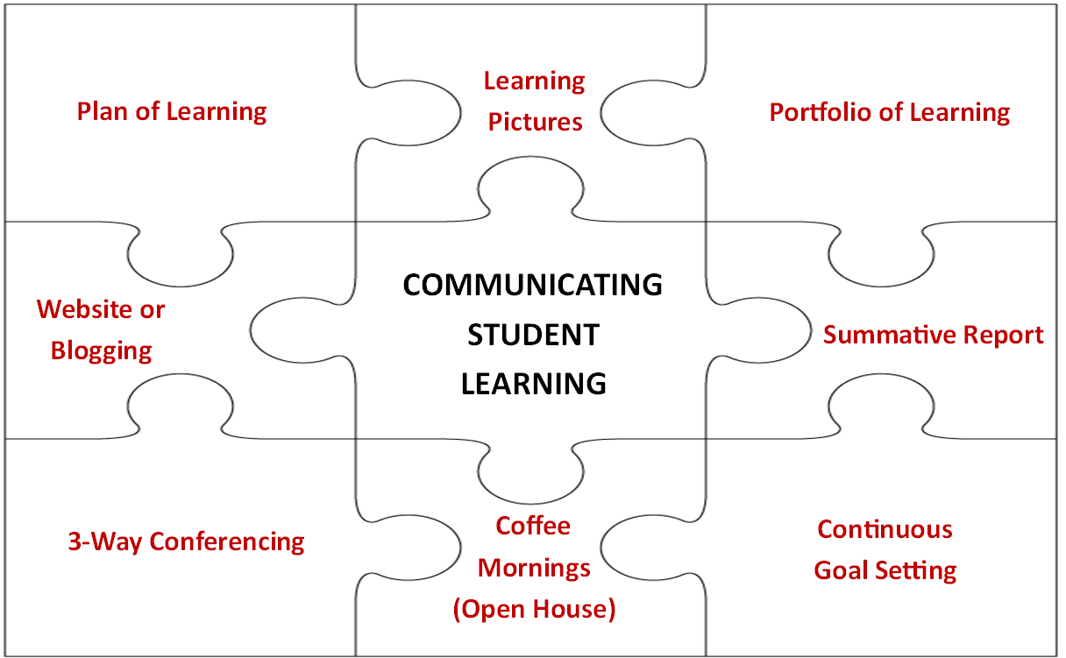
Notes:
One schools combined effort to look for intentional ways to communicate about student learning with parents – Hillcrest Elementary Surrey
Plan of Learning – letting parents know ahead of time some of the important, deep areas of learning that are planned
A class/school blog – kids contribute their thoughts to the blog as well
Learning pictures – ways of helping parents understand what learning looks like as it develops – writing down a hall from K – 7, showing the progression of learning
Student 3- way conferencing – sometimes during school time, while kids are in the class
Portfolio celebrations during class time so that parents can see their child’s progress – this was effective in schools where parents may not be going on the portfolio on a regular basis
Goal setting – sending home self-assessments, using electronic tools to build this in to the examples being sent home
Coffee Mornings – a way to invite parents in, make school a “known” place and provide an opportunity to build parents understanding of school, curriculum and leanring

Slide 47
Communicating Student Learning
What are some of the ways that you have found to effectively communicate student learning with parents?
What are some of the challenges? How have you addressed these challenges?

Slide 48
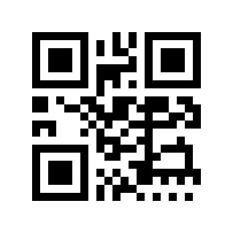
We want to develop an educational experience where:
Reporting is ongoing communication of student’s progress
Notes:
Stop making reporting an event that looks more autopsy like than growth oriented. We have the tools for this.
Consider: Fresh Grade use in Surrey, and the 2015 Cmolik Prize winner for Making Learning Visible

Slide 49
Communicating Student Learning and Reporting
Initial Principles posted – Redesigning Assessment
Provincial scan – practices around the province
“Innovation Hubs” exploring new, innovative practices
Teacher and Principal Working Group
3 Universities are involved in research
Policy and Guidelines document are under development
Reporting & Interim Policy for fall 2016/17
Additional consultation with parents and wider community

Slide 50
Across the Province – This is What I heard
Elementary has more effective formative assessment practices than secondary
Pockets of excellence at secondary
Deepen assessment practices, especially in descriptive feedback and questioning
Districts are trying new ways of communicating and reporting on student learning
Parents are gaining an understanding of the new curriculum and assessment. Districts, schools and teachers are providing support and education to PAC’s, DPAC’s and parents
Parents appreciate the face to face conferences and different ways that teachers’ and schools make learning visible

Slide 51
Communicating Student Learning (Reporting)
Provincial Scan
Interim Reporting Order K-9
Create Interim Reporting Order 10-12
Consultation K-9 school districts
across the province, Jan to March 2016
K-9 Reporting order for 2016/17 school year
Document to support practice
Consultation-parent engagement June -October
K-9 Reporting Order 2017/18
Interim 10-12 reporting order

Slide 52
The Goal of the Reporting Order at K - 9
Flexibility
Opportunity to shape requirements for a district context
Alignment of practices with reporting - portfolios, ongoing communication, student led conferencing, interactive conferencing
Ways to describe achievement/performance levels other than letter grades
Clear guidelines for the summative, year end report

Slide 53
Reporting to parents:
Clear, understandable language
Well informed about growth, progress, achievement – “no surprises”
Child’s learning is visible to the parent
Outlines the next steps, ways to support the development of the student
Outlines any specific interventions and significant supports
Provides a summary of the students learning experience
Notes:
clear, understandable language
parents are well informed about the growth, progress and achievement of their child
Makes learning visible - parents see their child’s learning; examples of student work, portfolio, student led, electronic tools
Communication provides an illustrative profile of the learner
Next steps in their child’s learning and development and ways they can be supported is clear
Provides information about the learner as a member of the learning community, how they approach learning and communicates that the teacher knows and cares about the learner
Outlines specific interventions and supports
Provides a summary and documents the student’s learning experience

Slide 54
Taking Stock - Where is your school, District?
What do parents want?
How have you helped them understand different ways of understanding student learning?
How have you made “learning visible to parents”?
In our schools, how can we support the change process?
What are your next steps?

Slide 55
Notes:
Acknowledge the uncertainty of implementing the redesigned curriculum (RC)
Feel comfortable with the dissonance of not knowing
Think about the Know, Do, Understand framework that is underlying the redesigned curriculum directed at learners
It is the same for teachers making sense of the redesigned curriculum: my presentation today is about the KNOWING; you will only UNDERSTAND the redesigned curriculum when you DO it!
Think big and act small: choose one aspect of the RC you are passionate about (e..g, ONE core competency, ONE discipline, ONE aspect of integrating the areas of learning, descriptive feedback, etc)

